Slide 1
Moles and LIMITING reactant or EXCESS reactant calculations

Slide 2
Calculations involving excess chemicals
Here when the reactants react making products, one of the chemicals will run out and then reaction will stop. The chemical left over is said to be in EXCESS and the chemical that has all reacted away is said to be the limiting reactant. It is the quantity of the LIMITING REACTANT that will dictate exactly how much reaction will take place.
Here we must use the 3 mathematical equations to calculate moles of the chemical we have , then use the balanced equation to look at how many moles would react with that chemical. Then use common sense to arrive at the answer
Worked example follows….

Slide 3
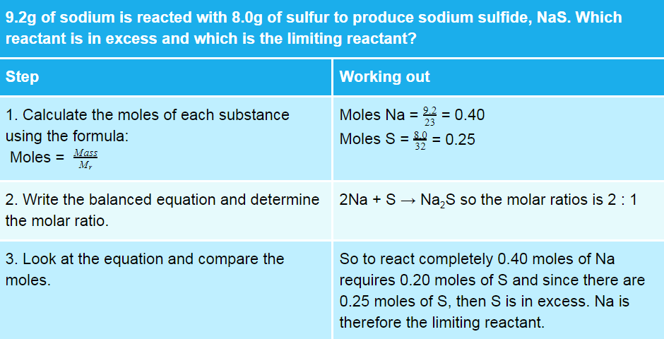

Slide 4
Moles and Yield calculations

Slide 5







Yield, what is it?
Yield for a chemical reaction is a measure of how much product is formed, and expressed as a percentage it gives information as to what proportion of reactants turn to products.

Slide 6

Yields for some common reactions
Some reactions do not happen, their yield is zero.
  E.g gold reacting with water
Some reactions happen fully such that all the reactants are used up, their yield is 100%
  E.g. Magnesium reacting with hydrochloric acid.
Some reactions are reversible reactions and their yield is always between 0 and 100%
  E.g. CH₃COOH dissolving in water making ions
Some reactions don’t produce as much of the products, as expected, sometimes due to impure reactants.

Slide 7











Example 1
a) What mass of ethanol is formed when 10.0g glucose are fermented according to the equation
C₆H₁₂O₆ 2C₂H₅OH + 2CO₂
b) If the percentage yield is 72.5%, calculate the actual mass of ethanol formed. (1)

Slide 8


Example 2
The expected mass of ammonium sulphate in an industrial experiment was 25.8 tonnes. The amount of ammonium sulphate actually formed gave a percentage yield of 85.6%. Calculate the actual mass of ammonium sulphate produced.

Slide 9






Example3,
What volume of hydrogen is formed when 1.27 g sodium react with cold water?
If the actual volume collected is 590 cm³, calculate the percentage yield.
2Na + 2H₂O → 2NaOH + H₂

Slide 10













