Slide 1
ATOMIC STRUCTURE
Drawing atoms, and linking to their periodic table positions

Slide 2
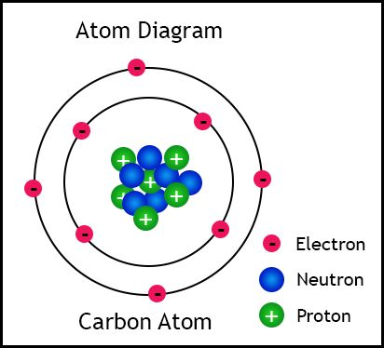
What subatomic particles make up the atom?

Slide 3
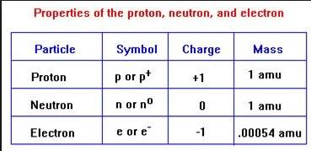







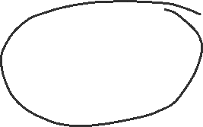










Slide 4




How many of each are in a specific atom?
Use the periodic table, lets consider Lithium……

Slide 5


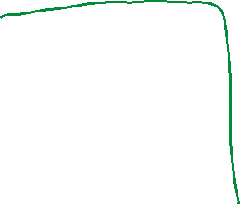







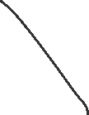



Slide 6



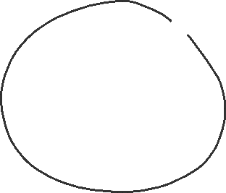










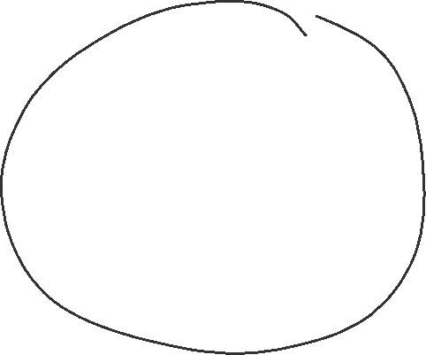



Slide 7





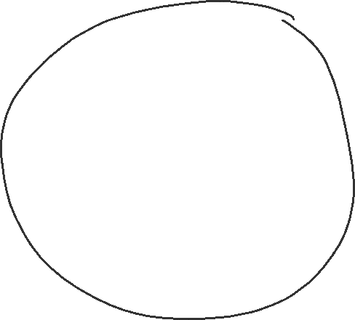




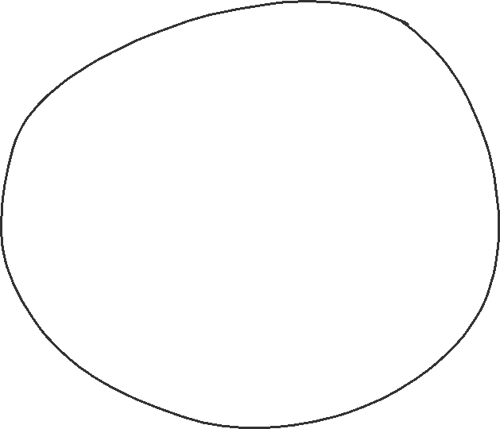

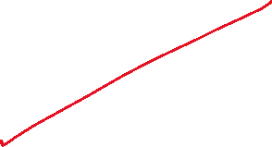




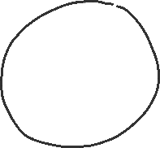



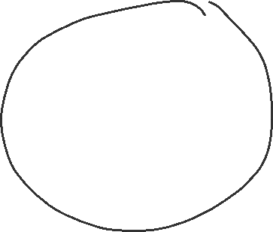



Slide 8


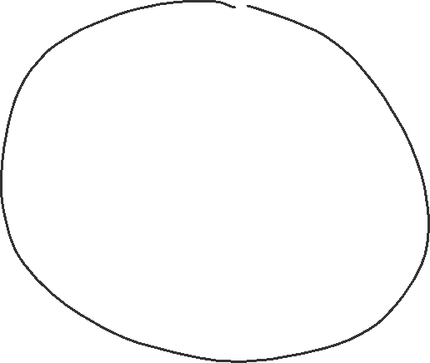



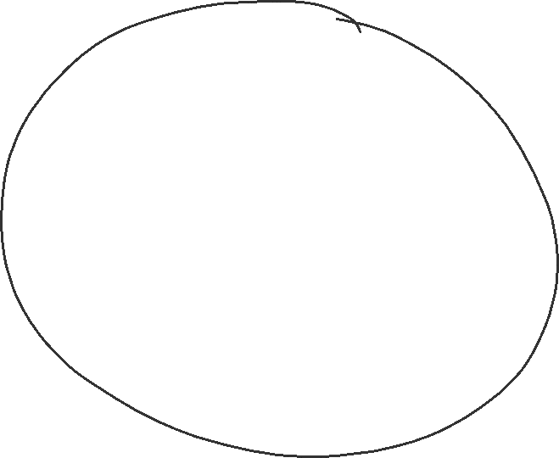


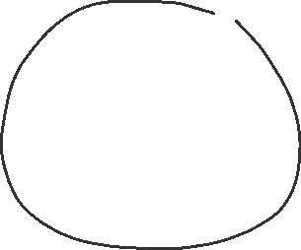
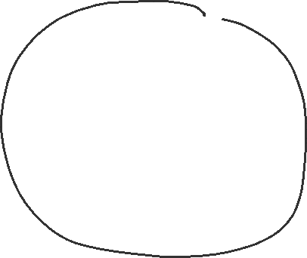

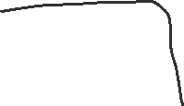
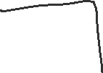

Slide 9








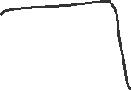



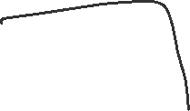




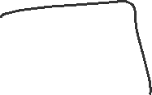





Slide 10
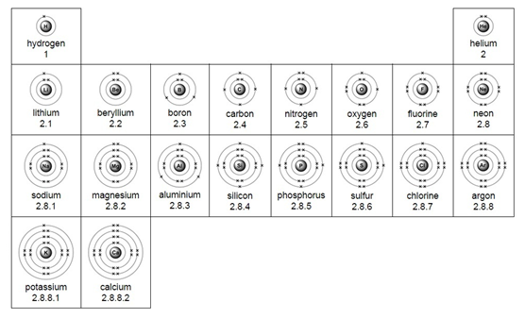












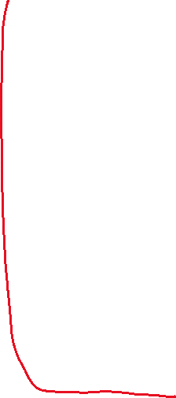



Slide 11

























Slide 12
SUMMARY
Number of protons = smaller number, ATOMIC NUMBER
Number of electrons for ATOMS = same as proton number
MASS NUMBER is the total number of protons and neutrons in nucleus, this is the bigger number
Subtract the number of protons from the mass number, to get the numbers of neutrons present in the nucleus
Arrange the electrons into energy levels, 2,8,8,remainder
Learn the pattern that the number of electrons that any element will have in its outermost energy level, is the same as the group number, even if it is very large.
Group 8 elements have FULL outermost energy levels of electrons

