Slide 1
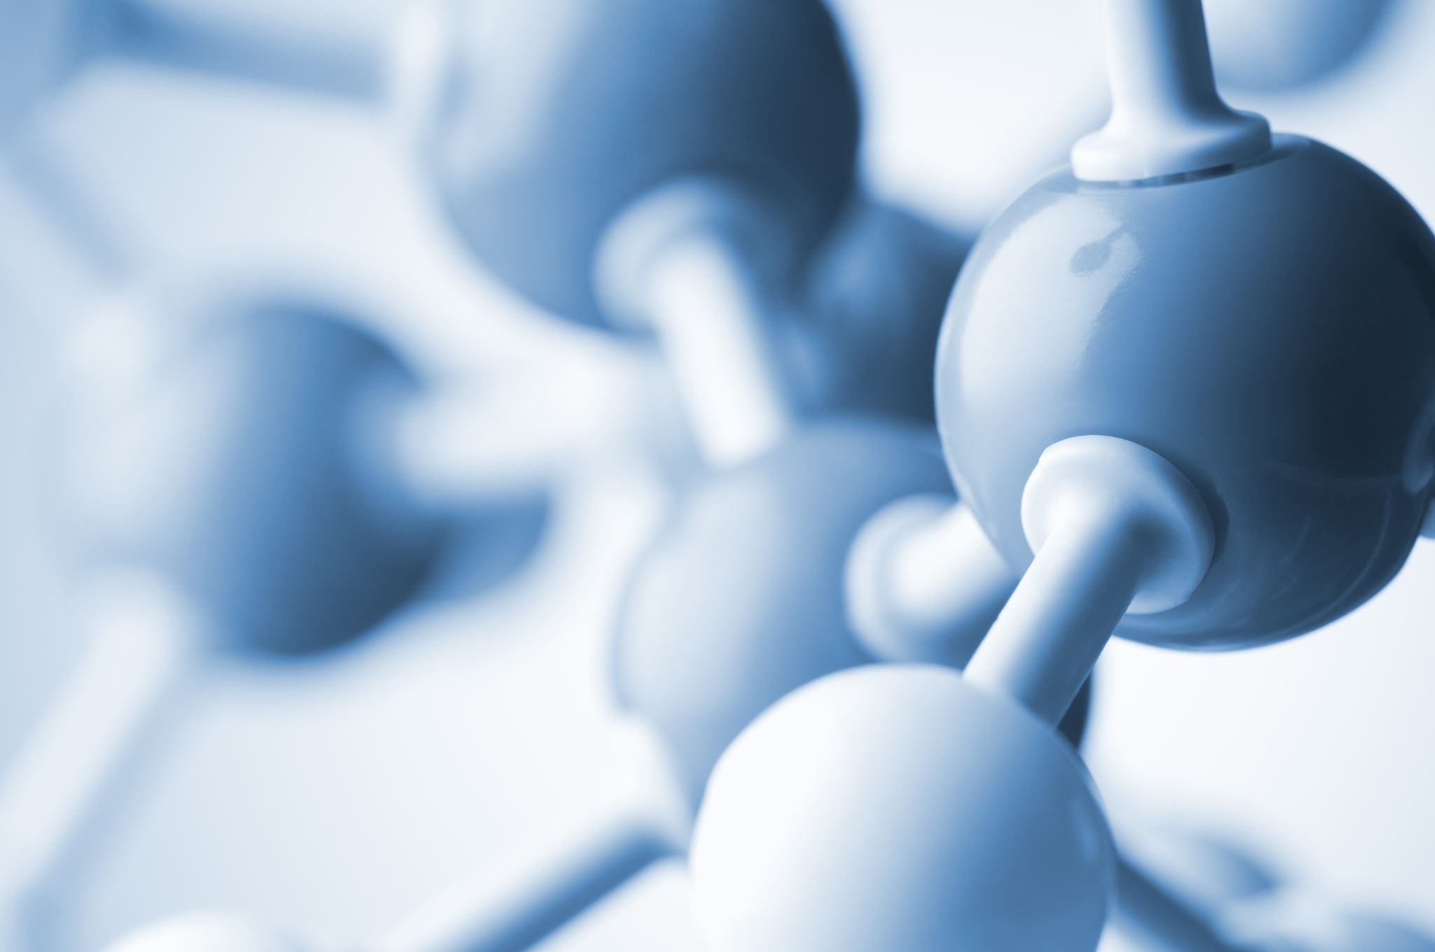
STRUCTURE & BONDING, continued….
What holds particles together, and what are the particles we have within chemicals

Slide 2
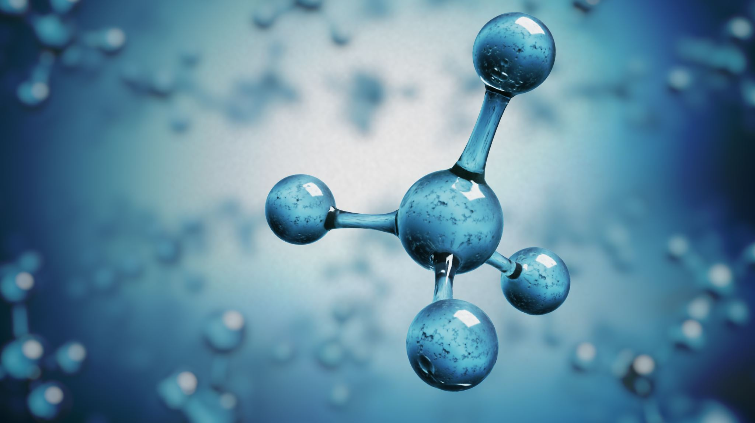
IONIC BONDING - continued transfer of electrons

Slide 3
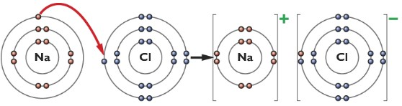
Recap sodium chloride – ionic compound

Slide 4
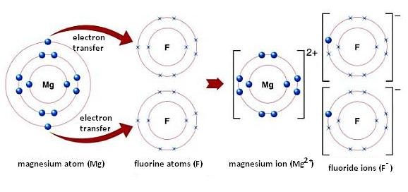



Consider magnesium fluoride

Slide 5
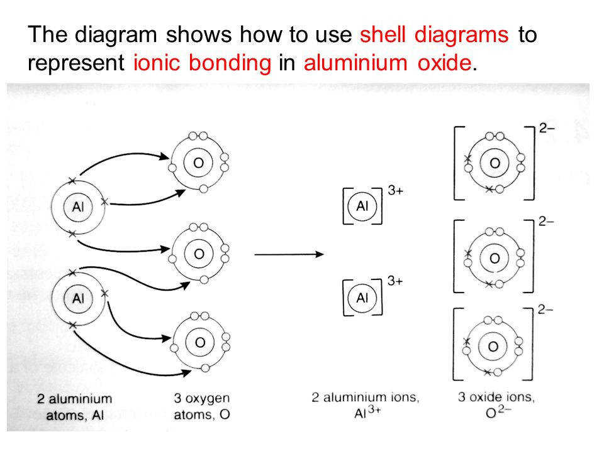







Slide 6
Summary of Ionic bonding
Ionic compounds are made up of IONS
Happens when a METAL element bonds with a NON-METAL element
Electron transfer takes place, metal atoms lose electrons and the non-metal atoms gain them.
So positive metal ions are formed alongside negative non-metal ions.
These ions attract each other, due to STRONG electrostatic attractions between positively charged ions and negatively charged ions formed.
The ions become arranged into a crystal lattice which is a 3D giant repeating pattern, where the ions are held in their places by these strong ionic bonds
Ions are arranged ALTERNATING +ve and –ve ions, attractions outweigh the repulsions present within the lattice structure.
Ionic bonds are simply electrostatic attractions between the +ve and –ve ions present.
Ionic compounds have high m.pts. and b.pts.
Ionic compounds do not conduct electricity when SOLIDS
Ionic compounds do conduct electricity when LIQUIDS or dissolved in water
Many ionic compounds dissolve in water but some do not.
The chemical formulae of the compound will tell us the ratio of the positive ions to the negative ions within the compound

Slide 7
COVALENT BONDING
Sharing of electrons

Slide 8
Covalent bonding = non-metal elements with other non metal elements.
Non metal elements GAIN electrons easily. So consider two non-metal elements where they both need to gain electrons in order to fill up their outermost enery levels, how would they bond together,
It should be clear that electron transfer will not lead to both elements becoming stable, so what does happen??
It is electron sharing that happens, the sharing of electrons occurs to give BOTH elements full outermost energy levels.
Lets consider water as an example, where as non-metals both Hydrogen and Oxygen need to gain electrons to get full outermost energy levels

Slide 9
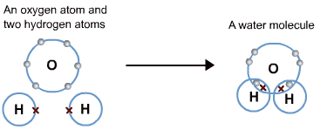
Water, H₂O

Slide 10
Covalent bonding – important ideas
The sharing of a PAIR of electrons is a covalent bond
The shared pair of electrons is attracted by the nuclei of two different atoms, and this is what holds the two atoms together. A covalent bond is sometimes drawn as a stick in diagrams
Sharing of electrons is a STRONG type of bonding, so covalent bonds are STRONG.
Definition of molecule = a collection of atoms covalently bonded together
So with covalent bonding, we end up forming MOLECULES

Slide 11
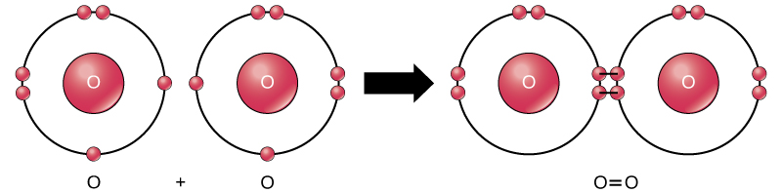
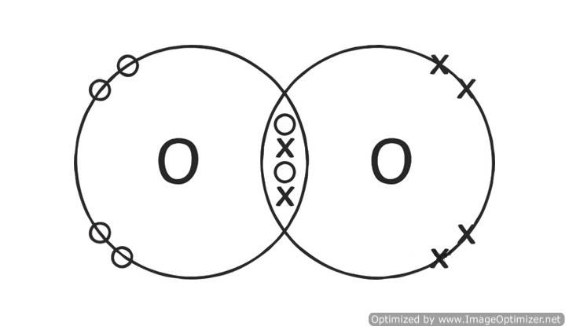
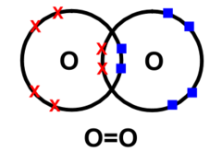
Drawing dot and cross diagrams for molecules

Slide 12
You try drawing dot and cross diagrams for the following molecules, and draw stick diagrams too.
Hydrogen gas, H₂
Carbon dioxide gas, CO₂
Ammonia gas, NH₃
Nitrogen gas, N₂
Water, H₂O
Methane, CH₄
Ethanoic acid, CH₃COOH

Slide 13



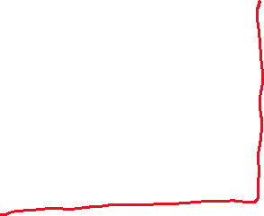
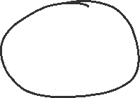




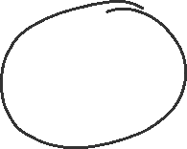


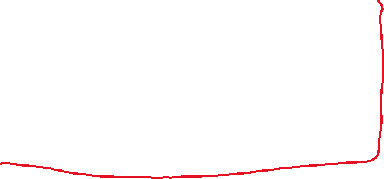
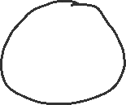



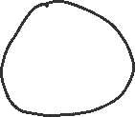
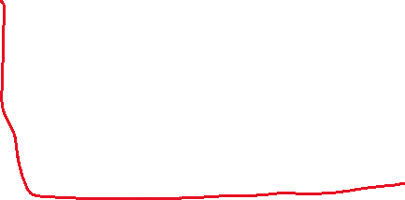
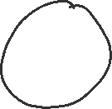

Slide 14
Molecular formulae
The molecular formulae, will tell us exactly the number of atoms of each element present within each molecule.
e.g. H₂ , O₂ , N₂ , F₂ , Cl₂ , Br₂ , I₂ , these important COMMON super seven elements exist as diatomic molecules in our world. As diatomic molecules they have FULL outermost energy levels of electrons and are therefore STABLE. Ignoring hydrogen, the other six trace out a shape of 7 on the periodic table…. Learn this idea.
Other elements are not diatomic, e’g. S₈, P₄, Ar,
Group 8 elements exist as ATOMS because they have full energy levels already The other elements will NOT exist as atoms, since their atoms do not have full outermost energy levels, so the non metal elements undergo covalent bonding, forming molecules which have full outermost energy levels, be stable and exist as these molecules.
Compounds between non-metals are similarly therefore covalently bonded to give all the atoms within the compound full outermost energy levels, and dot and cross diagrams are used to explain how many electrons are shared. Practise drawing these dot and cross diagrams, Pupils need lots of practice here to get to a point where they can confidently draw molecules.

Slide 15
STRONG and WEAK attractions
This is a very important point and commonly misunderstood by pupils…
N:B
Molecules attract each other…. These INTERMOLECULAR (between molecules) forces of attraction are WEAK, and are therefore easily broken!
Within molecules the atoms are held together by STRONG covalent bonds, so the covalent bonds within molecules are not easily broken, they are HARD to break!

Slide 16
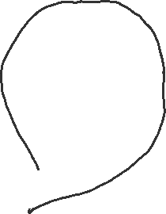









Strong bonds within molecules, but weak attractions between molecules!
Water in a beaker
Carbon dioxide in a balloon

Slide 17
Melting points and boiling points of covalent (molecular) substances
When we BOIL or melt covalent substances we ONLY have to break the attractions between molecules (intermolecular forces of attraction), these are WEAK, easily broken, so m.pts. and b.pts. are LOW for these compounds. So many covalent compounds are gases or liquids at room temperature as these attractions have already broken down at 25ºC.
Boiling or melting will not involve breaking the covalent bonds!

Slide 18
Electrical conductivity
Conduction of electricity requires us to have present either..
i) Freely moving electrons OR
ii) Freely moving ions
Covalent substances are made up of molecules, they don’t have free ions.
All the electrons are held within electron energy levels, so there are never any free electrons
Consequently covalent solids, liquids and gases do not conduct electricity, as they don’t have free ions or electrons present.
However SOMETIMES a covalent compound will dissolve in water, reacting with it and making ions, which move freely within the new solution and so that solution will conduct electricity. e.g. Hydrochloric acid conducts…. It is made by dissolving HCl gas in water
HCl(g) + H₂O(l) → H⁺ (aq) + Cl⁻ (aq)

Slide 19
DISSOLVING covalent substances into water
Many covalent substances do not dissolve in water (water and oil)
Few covalent substances do dissolve in water ( water and alcohol)
Some covalent substances react with water to make an ionic solution which will conduct electricity ( water and hydrogen chloride gas)

Slide 20
SUMMARY of covalent bonding
Happens when non-metal elements bond together.
Since they need to gain electrons to get full outermost energy levels of electrons, then they SHARE their outermost electrons to get those FULL.
The sharing of a pair of electrons, attracted by two nuclei is a covalent bond, and often represented by using a stick in diagrams such as displayed formula diagrams. Covalent bonds are STRONG bonds, which are hard to break.
When covalent bonding happens we form MOLECULES.
Molecules can be drawn as dot and cross diagram, to show which electrons are being shared
Molecules are collections of atoms held together by covalent bonds. They have STRONG covalent bonds within each molecule, but WEAK INTERMOLECULAR forces of attractions between the molecules, which are easily broken.
Covalent compounds have LOW mpts, and low bpts. Explain
Pure covalent compounds do not conduct electricity. Explain
Some dissolved covalent compounds do conduct electricity. Explain
Many covalent compounds do not dissolve in water but some do, and some react with water as they dissolve.

