Slide 1
REACTIVITY OF METALS AND NON METALS
Incorporating REDOX ideas

Slide 2
What about non metals?
Lets look at the halogens, group 7 elements
Again lets mix halogens with various halide ions solutions, and explain
Take halogens, Chlorine, Bromine and Iodine in water, these solutions are coloured
MIX these together with Sodium Chloride (aq), Sodium Bromide (aq) and Sodium Iodide (aq). Theses solutions are colourless
Look to see when there is a reaction, by looking to see if a noticeable colour change occurs
Ensure any colour change you record is not simply a dilution.
The results we get will be like this………

Slide 3
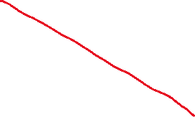
 | NaCl (aq) Colourless soln | NaBr (aq) Colourless soln | NaI (aq) Colourless soln
Chlorine water Cl₂(aq) Pale green solution | 1 | Reaction 4 Pale green mixture goes red | Reaction 5 Pale green mixture goes purple
Bromine water Br₂(aq) Red solution | No reaction 7 Just dilution | 2 | Reaction 6 Red mixture turns darker, red/purple
Iodine water I₂(aq) Dark purple solution | No reaction 8 Just dilution | No reaction 9 Just dilution | 3

Slide 4

The more reactive HALOGEN will end up in solution as the HALIDE IONS
Lets look at the REACTIONS, 4, 5, and 6, such as reaction 5
Cl₂(aq) + 2NaI(aq) → I₂(aq) + 2 NaCl(aq)
Since chlorine is more reactive than Iodine it ends up as Iodide ions, the less reactive halogen, in this case IODINE ends up being displaced from its ions
Then NO reactions 7, 8 and 9, such as reaction 8
I₂(aq) + 2NaCl(aq) → no reaction
Since I₂ is not reactive enough to displace chloride ions there is no reaction

Slide 5
NO REACTIONS 1, 2 and 3, will show NO OBSERVABLE CHANGE, as the products of such reactions are identical to the reactants we start with.
e.g Cl₂(aq) + 2NaCl(aq) → Cl₂(aq) + 2NaCl(aq)
N:B
HALOGENS are the diatomic elements, Cl₂, Br₂, I₂
HALIDES are the ions of the halogens, Cl⁻, Br⁻, I⁻
Using reaction 4, we find Chlorine more reactive than Bromine…. Then
Using reaction 6, we find that Bromine is more reactive than Iodine.
So the order of reactivity is CHLORINE, then BROMINE, then IODINE

Slide 6
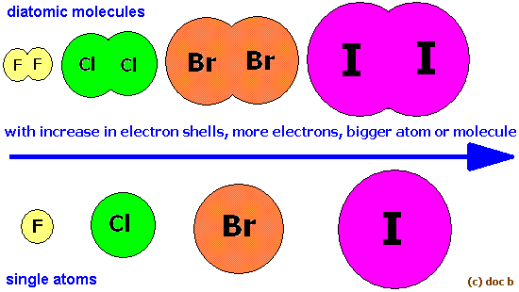

Reactivity DECREASES down group 7 , elements

Slide 7




Explanation – why does reactivity increase as we move down group 7?
Halogens react by gaining electrons, and they form halide ions when reactions happen
X₂ + 2e⁻ → 2X⁻
The halogen atoms further up the group, are SMALLER, so they are able to attract electrons more strongly, since the nucleus is closer to the outerside of the atom….
So making negative halide ions is easier with elements further up the group

Slide 8
These reactions as REDOX reactions
Cl₂(aq) + 2NaI(aq) → I₂(aq) + 2 NaCl(aq)
Cl₂(aq) + 2I⁻(aq) → I₂(aq) + 2Cl⁻(aq)
Cl₂ molecules accept/gain two electrons and turn into 2Cl⁻ ions, so chlorine molecules are being
REDUCED to chloride ions, as shown by this ions/electrons equation
Cl₂(aq) + 2e⁻ → 2Cl⁻(aq)
Na⁺ ions are spectator ions, so the ionic equation would be as above
Two Iodide ions lose two electrons turning into molecules of Iodine, so iodide ions are being OXIDISED to to iodine molecules, shown as this ion/electrons equation
2I⁻(aq) → I₂(aq) + 2e⁻

